Slide 1

An introduction to
By Jurek Baumann
https://github.com/JurekInholland

Slide 2

What is GitHub?
GitHub is not git.
Notes:
I really want to clarify some technical basics to hopefully provide a comprehensive understanding of GitHub and therefore git.
I think this is the most important thing to learn in the beginning. And understanding this well enough to be able to incorporate GitHub without much stress into your daily work

Slide 3
What is git then? And what is GitHub?
git | GitHub
Open source software https://github.com/git/git | A hosting service for git repositories
A command-line tool | A social platform for collaborating and communicating.
A revision (version) control system | Is a consequence of the emergence of git and one of numerous hosting services.
Developed by Linus Torvalds https://github.com/torvalds | Recently bought by Microsoft for $7.5B
Git is the underlying technology while GitHub adds offsite backups, collaboration and communication features as well as additional software, such as GitHub Desktop that makes our lives easier. Especially when working together.

Slide 4
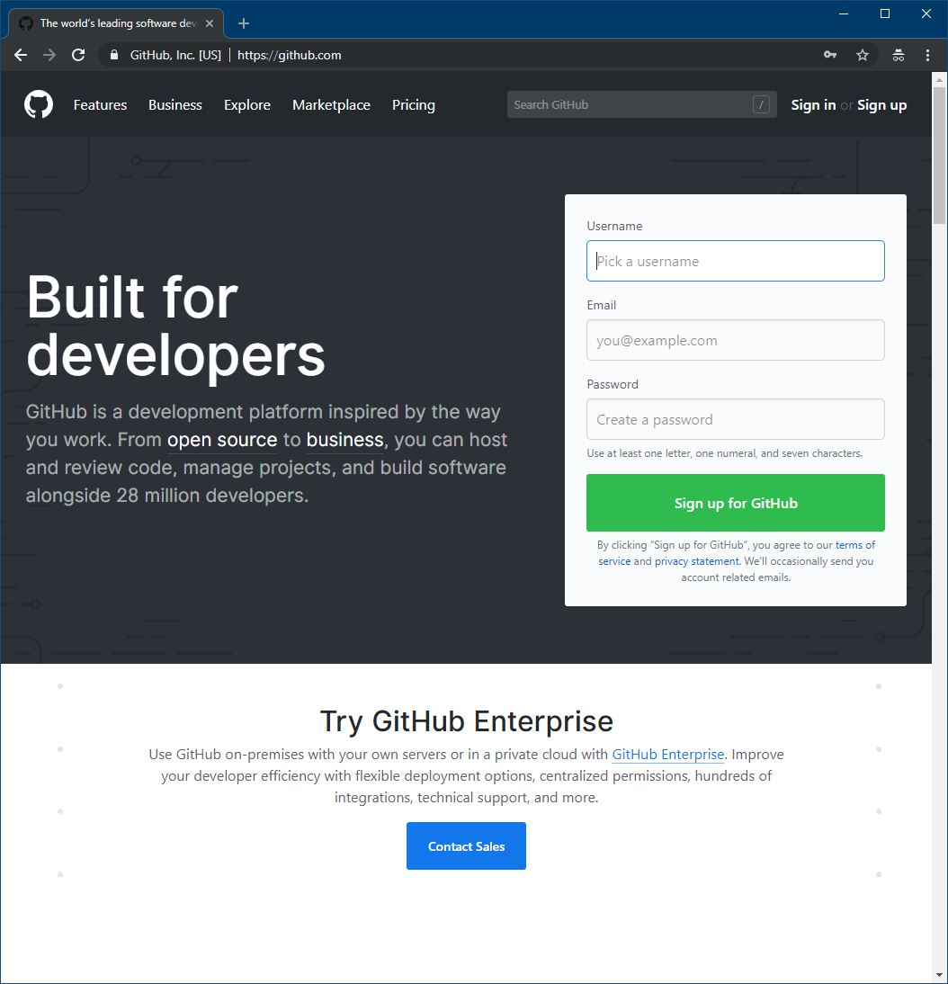
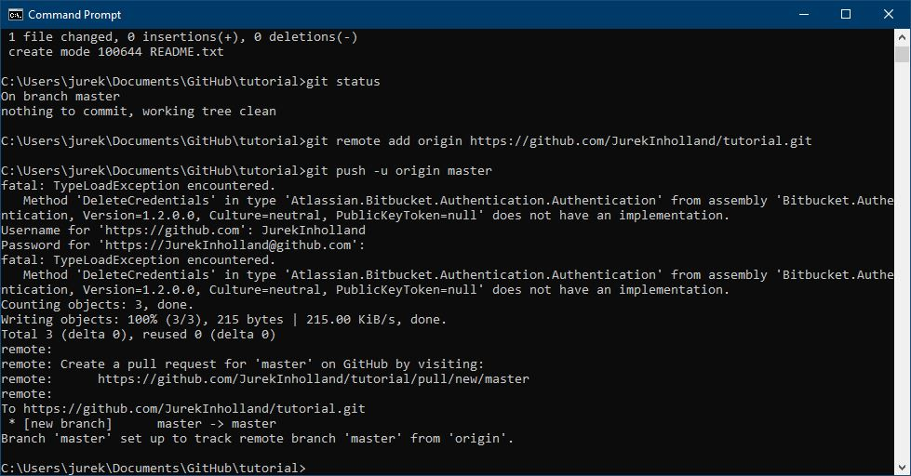
git vs. GitHub
git
GitHub
Notes:
Create an account on GitHub now if you don’t have one yet or else make sure to be logged in, if you want to follow along.

Slide 5
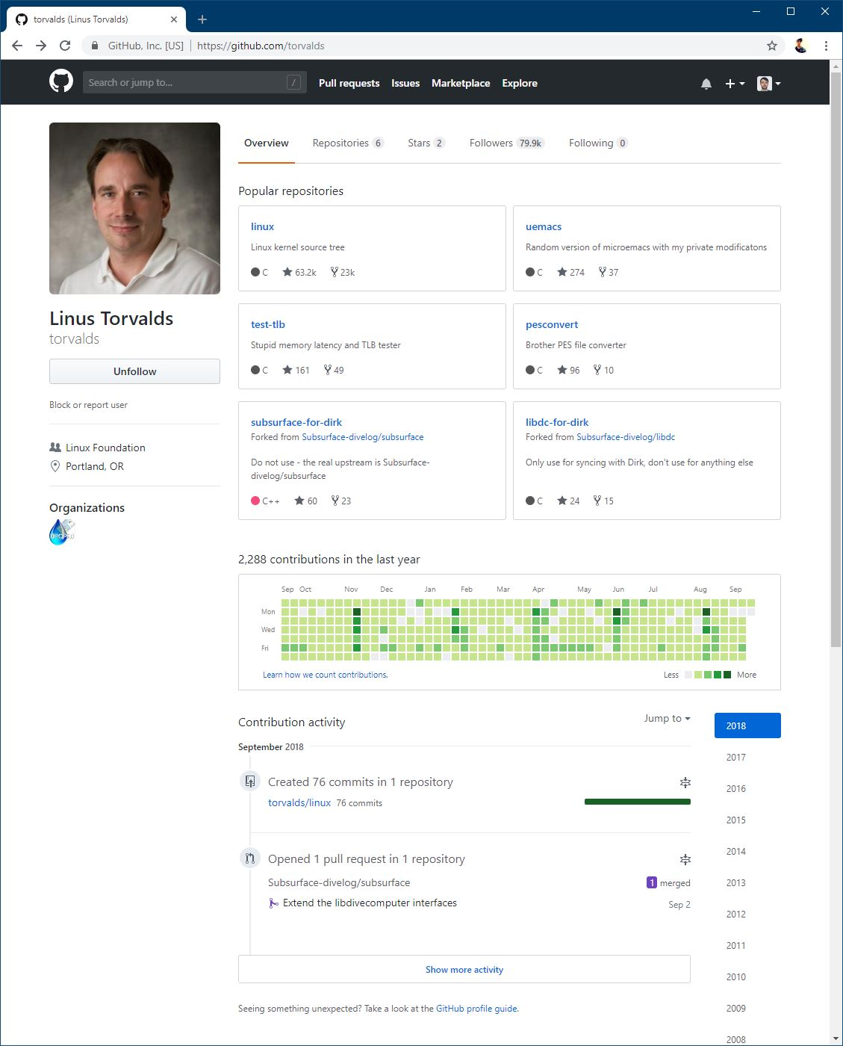
Let’s look at someones GitHub profile
These are repositories.
A repository is a central place where related data and files are stored. A computer program or a website, for example.
This is a visualization of historical activity.
The more productive you are on a given day, the stronger saturated the green color of that square becomes. If you do nothing, the square stays grey.
Notes:
(Meanwhile)
This is the creator of git and Linux. Who better to take a quick glance at their profile than him.
As an aspiring programmer you should have one god and one god only and that’s him.
Probably more than half of all computers/servers/mobile phones in existence run Linux or at least parts of it
--- repositories
Besides name and description, GitHub automatically displays the predominant programming language, as well as social features such as stars and forks which we will discuss later.
--- activity
Try to use the visual representation of your activity
→ Okay let’s create a new repository now and do it completely from scratch, at least once

Slide 6
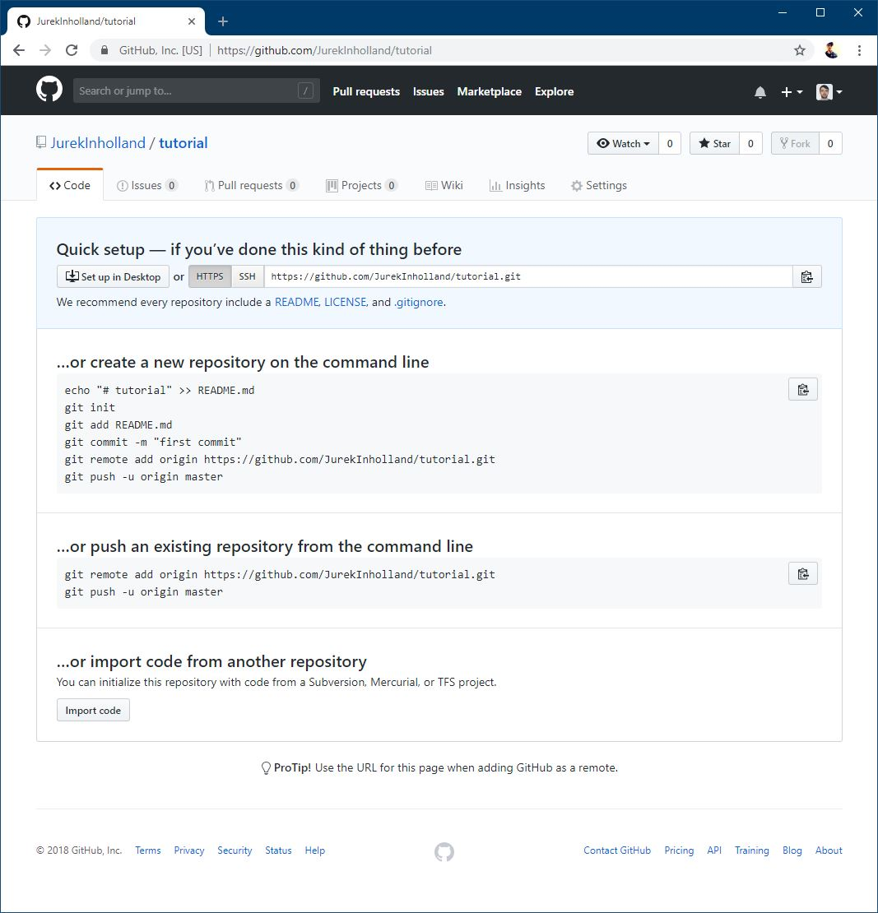
How to do it from scratch
Create a new folder that is going to contain the files of your new repository. To make things easier, make sure this folder is inside your user folder like C:\Users\jurek\Documents\GitHub\tutorial for example.
Go to github.com and create a new repository. Name it however you want. tutorial for example.
Open up a command prompt (Start -> type in cmd -> press enter)
Navigate to your newly created folder by typing ‘cd’ and pasting the path to it.
Notes:
4: cd is an acronym of current directory

Slide 7
How to do it from scratch
git init Initiate a new empty local git repository.
git add -A Add all files inside the current folder to the repository. Every change from now on will be tracked.
git commit -m "add readme.txt" Commit latest changes (the addition of our readme file). This creates a snapshot of the current state of our repository.
git remote add origin https://github.com/JurekInholland/tutorial.git Link the local to the remote repository.
git push -u origin master Push i.e. upload your files or rather the changes to your files to GitHub.

